Slide 1

Information Architecture
Juntao Chu

Slide 2
Home Recipes Quick & Easy In The Kitchen Table Talk Holidays & Seasons About Us
Outline
Recipes
Breakfast Lunch
Dinner
Dessert
Snack & Appetizers
Holidays & Seasonal Recipes
Recipes By Diet
Recipes By Method
Recipes By Ingredients
Recipes By Cuisine
Quick & Easy
Quick Dinners Easy & Healthy
Quick Vegetarian
Easy Pastas
Table Talk
Most Recent News & Trends
Voices
Groceries
Features
In The Kitchen
Simply Curious
Tips & Techniques
Ingredient Guides
Holidays & Seasons
The Grill-Up Come On Over
Summer Salads

Slide 3
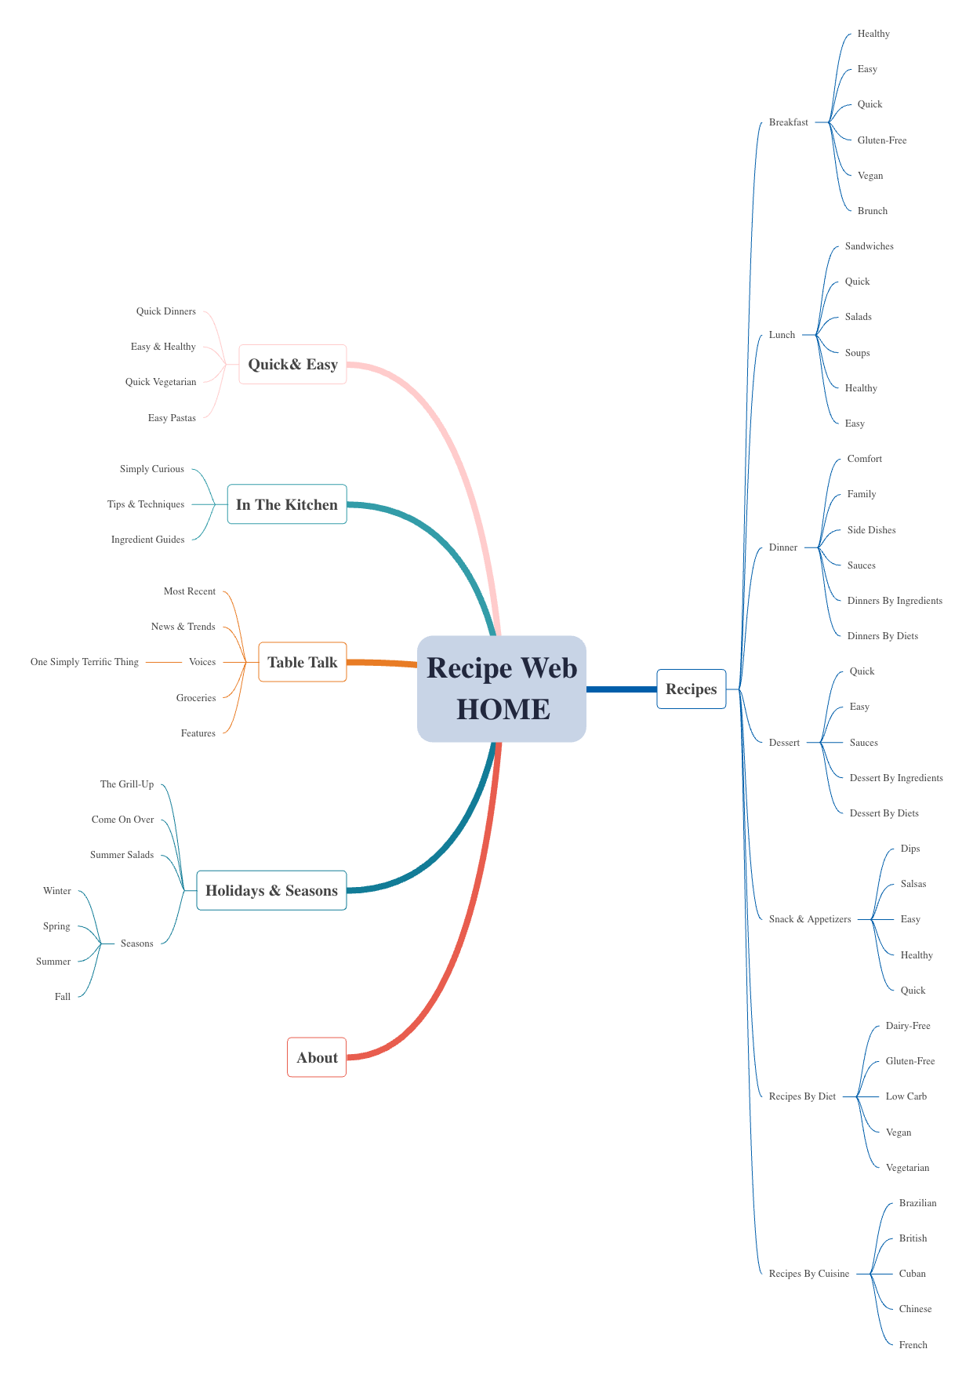
Diagram The Site Map

Slide 4
Reference:
Simply Recipes, n.d. www.simplyrecipes.com. Accessed 15 Sept. 2023.

